Slide 1


Case Study – 1
Predictive Maintenance in Solar Power Systems

Slide 2
Team Members
Team ID | Name | Role
S4F_CP_Team_12328 | VINISHA. S | Team Leader
S4F_CP_Team_12328 | SAJITHA S | Team Member 1
S4F_CP_Team_12328 | DHANUSHA. S | Team Member 2
S4F_CP_Team_12328 | VIDHYA BHARATHI S | Team Member 3

Slide 3
Content
Abstract
Problem Statement
Objective
Data Collection and Preparation
Proposed Solution (Methodology)
Model Performance Evaluation
Screenshots / Demonstration (video)
Future Scope
Conclusion
Notes:
Abstract
Problem Statement (Clearly define the challenge)
Objective (State your project's goal)
Background and Research (Discuss existing solutions, trends, and gaps)
Data Collection and Preparation (Focus on data sources, cleaning, and augmentation)
Proposed Solution (Methodology)
Model Architecture (e.g., CNN, U-Net, YOLOv5)
Key Techniques (e.g., Transfer Learning, Image Augmentation)
Model Performance Evaluation
Metrics (Accuracy, Precision, Recall, IoU, etc.)
Graphs (Confusion Matrix, ROC Curve, etc.)
Screenshots / Demonstration (Visual proof of system functionality)
Future Scope (Improvements, scalability, and integration ideas)
Conclusion (Summarize results and impact)
Q&A Session

Slide 4
Abstract
Predictive maintenance in solar power systems enables early detection of equipment issues, reducing unexpected failures, improving energy output, and cutting costs. Using machine learning on sensor data (temperature, voltage, current), this case study demonstrates how AI can transform traditional maintenance into a smarter, more sustainable process.

Slide 5
Problem Statement
Solar plants face challenges like:
Over-maintenance, leading to unnecessary costs
Under-maintenance, causing unexpected failures and energy loss Traditional fixed schedules lack accuracy and adaptability. Solution: AI-based predictive maintenance can identify failures early, optimizing maintenance actions and minimizing downtime.

Slide 6
Objective
The main goals of this case study are:
Develop a machine learning model to predict inverter failures
Reduce maintenance costs and prevent breakdowns
Enhance energy production by ensuring optimal system operation
Support sustainability through efficient resource use

Slide 7
Data Collection and Preparation
Dataset: 1000 samples of simulated solar sensor data
Features:
Temperature (°C)
Voltage (V)
Current (A)
Target: Inverter status – healthy, degrading, failed Preprocessing:
Removed missing/duplicate values
Scaled features for uniformity
Split into training and test sets

Slide 8
Proposed Solution (Methodology)
Algorithm Used: Random Forest Classifier
Steps:
Feature scaling with Standard Scalar
Model training (70% train / 30% test)
Prediction of inverter health status
Tools: Python, pandas, scikit-learn, matplotlib Why Random Forest? Handles non-linearity well, robust to noise, and interpretable feature importance.

Slide 9
Model Performance Evaluation
Results:
Accuracy: ~94%
Precision / Recall / F1-score: High across all labels
Evaluation tools:
Confusion matrix
Classification report
Cross-validation - Feature importance showed temperature as the top predictor of failure.

Slide 10
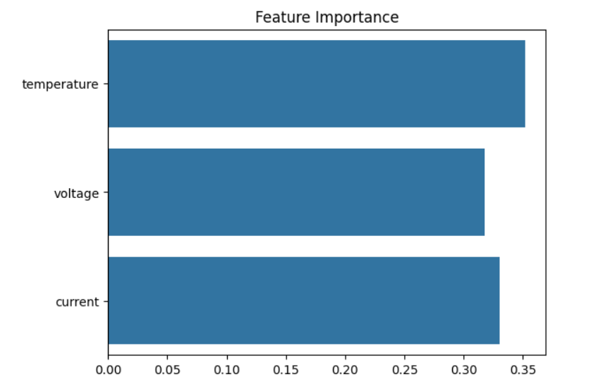
Screenshots / Demonstration (video)
GitHub Link:
https://github.com/vinisha8904/AI-and-Green-Skills-Case-Study--1/tree/main

Slide 11
1. What features in the dataset are most important for predicting equipment failures?
Temperature: High temperatures often signal overheating or stress in the system.
Voltage: Voltage drops can indicate inverter degradation or malfunction.
2. Develop a machine learning model to predict inverter failure.
Use a Random Forest Classifier trained on temperature, voltage, and current data.
Evaluate using accuracy, precision, recall, and a confusion matrix for performance.

Slide 12
3. How would you improve the model's accuracy?
Add more features like irradiance, humidity, or dust levels for better context.
Use advanced models (e.g., XG Boost, LSTM) and tune hyperparameters.
4. What actions should be taken if a failure is predicted?
Send real-time alerts to technicians or maintenance teams.
Schedule proactive maintenance to prevent system downtime or damage.
5. How can predictive maintenance contribute to sustainability and reduce waste?
Prevents unnecessary replacements, saving materials and reducing waste.
Improves energy efficiency, supporting sustainable and reliable power generation.

Slide 13
Future Scope
Enhancements ahead:
Integration with real-time IoT sensors
Use of deep learning (LSTM) for time-series prediction
Apply to other components: panels, batteries
Deployment on the cloud for remote monitoring
Support predictive analytics across renewable energy grids

Slide 14
Conclusion
Predictive maintenance boosts:
Efficiency in operations
Sustainability by reducing waste
Cost-effectiveness by minimizing manual checks This case study proves that AI-driven models can revolutionize solar power system maintenance, leading to a greener and more reliable energy future.

